Slide 1


Fundamentals of RM
RM System and Process
Leadership in RM
Incident Investigation
RM Tools & Challenges
RM in Industry
People & Org.
Application and Perspectives
On Becoming a
Leader in Risk Management
ENGG404 - Lecture
Final Exam Date & Time,
and Location

Slide 2
Purpose and Learning Outcomes:
Purpose of this lecture:
Communicate the date, time, and location of the Final Exam.
Communicate about how to prepare for the Final Exam
Learning Outcomes of this lecture:
You will know when and where the Final Exam will be held.
You can explain how to prepare for the Final Exam.
More information will be shared later in the term e.g. nature of questions, format, content which will be covered, etc. in Topic #67 Expectations, Preparation, and Instructions For Writing the Final Exam
Defer your questions, please!
Expectations and Instructions For Writing the Final Exam
‹#›
Notes:
‹#›

Slide 3
Final Exam Day, Time, and Location:
Location for Writing:
The final exam will be administered on-line through eClass, much the same manner as the quizzes and assignments.
The final exam will not be on-campus at LAC, so essentially this means that you, the students, will be able to write the exam at any location of your choosing.
  Comfortable space – light, temperature, seating, accessibility
  Set-up for no interruptions (let your family members know)
  Reliability: computer power supply and internet access
  ExamLock will NOT be used.
  No on-line proctoring system will be used.
Expectations and Instructions For Writing the Final Exam
‹#›
Notes:
‹#›

Slide 4
Final Exam Day, Time, and Location:
Day and Time for Writing:
Wednesday 27-April-2022, starts at 9:00AM MT (University Time), three (3) hours duration.
Conflicts, Accommodations, and Overseas Students:
Some students will have final exam conflicts.
  For conflicts, the alternate is 27-April-2022 at 2:00PM-5:00PM.
Students who are overseas and wish to write during “daylight” hours at your location, you must self-elect:
  Send an email to Cocchio@ualberta.ca
  For overseas student, the alternate will be ~10 to16 hours earlier.
All those with conflicts, accommodations, or self-elected overseas will receive further information via email in the weeks prior to the exam.
Expectations and Instructions For Writing the Final Exam
‹#›
Notes:
‹#›

Slide 5
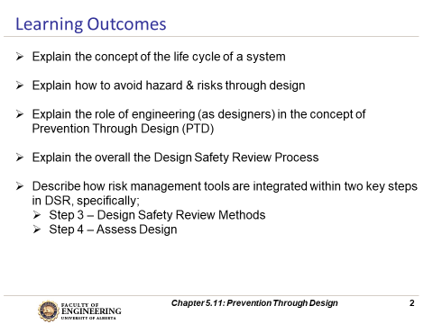
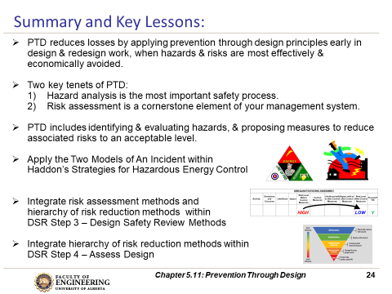
Final Exam – How to Prepare for It!
The Final Exam is challenging!
Final Exam Preparation:
Review concepts, principles, and practices AND
Apply them, AND
Assess yourself on the “Learning Outcomes”.
Q: One question that is often asked is,
"What and how do I study for the final exam for this course?"
A: The brief answer:
Each lecture Topic PPT starts with a slide that lists
the "Learning Outcomes" and ends with a slide (or
two) that lists the "Summary and Key Lessons".
Review the content on these lists to determine
your level of skill and confidence in explaining /
applying those learning outcomes and the
summary and key lessons, and as a guide to direct
your preparation efforts.
ENGG404 Expectations, Course Syllabus, Course Plan, and Exam
‹#›
Notes:
‹#›

